Slide 4
1. Cum te numești?
Să ne cunoaștem
4. Ce așteptări ai de la întâlnirea de azi?
Notes:
DespreMine
Inceput acum 8 ani cu programare web
Acum 6 ani am trecut pe .Net
Acum 4 ani lansarea .Net Core
Activitati educative - shareuiesc cu predilectie ce imi place mie

Slide 5
Agenda
The state of .Net
Does front-end mean Javascript any more?
The state of front-end development – what is Web Assembly?
Exploring Blazor
Short live demo developing a simple app faster than ever

Slide 7

Let’s get to business
Building SPA’s

Slide 8
A history of front-end development
Modern SPA Frameworks:
React, Angular, Vue
Web Assembly
Transpilers:
TypeScript, CoffeeScript
Other front-end languages attempts:
SilverLight, Adobe Flash
Libraries:
jQuery
Pure JavaScript
Notes:
- Incercarea developerilor de a gasi alternative la JS
Web Assembly:
1. Vrem mai multe alegeri de limbaje
2. Daca pe backend putem alege orice limbaj de ce nu si pe front?

Slide 9
What is Web Assembly?
Wasm is designed as a portable compilation target for programming languages, enabling deployment on the web for client and server applications. (webassembly.org)
Efficient and fast (runs at native speeds)
Supported by all major browsers (, , , )
A lot of languages already compile to WASM
C# - with our star today - Blazor 😁
C++ (with Emscripten, Rust, Kotlin, Swift and others)
Notes:
Does front-end mean javascript any more? Obviously, no!

Slide 10
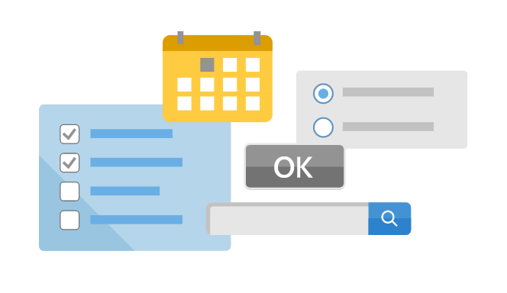
What is Blazor
- Blazor lets you build interactive web UIs using C# instead of JavaScript
- Blazor apps are composed of reusable web UI components implemented using C#, HTML, and CSS
- Both client and server code is written in C#

Slide 11
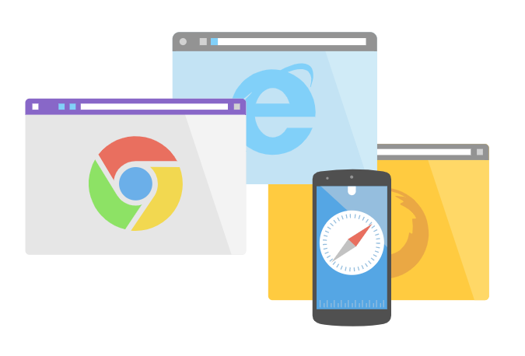
Advantages
- All the benefits of a modern SPA framework: Reusable components, routing, dependency injection, 2-way binding
- Wide browser support, including mobile browsers
- Blazor was shipped with .Net Core 3.1 which is a LTS (long time support) version

Slide 12
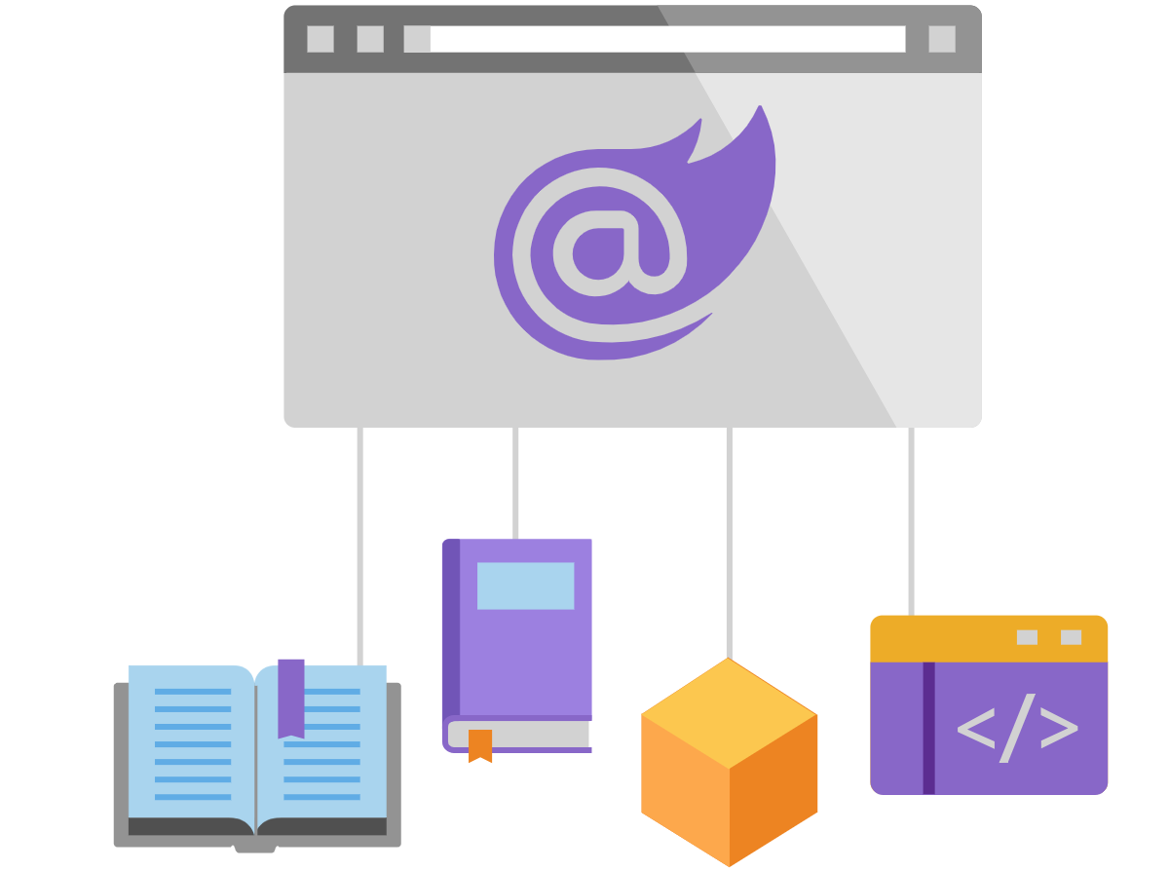
Advantages
- Use a single language (C#) end-to-end - benefit from .NET's performance, reliability, and security
- Use the existing .NET ecosystem of .NET libraries

Slide 13
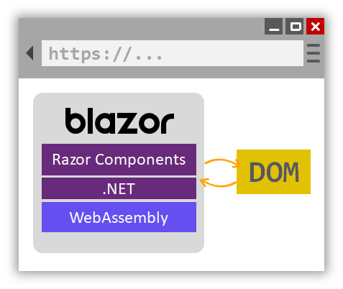
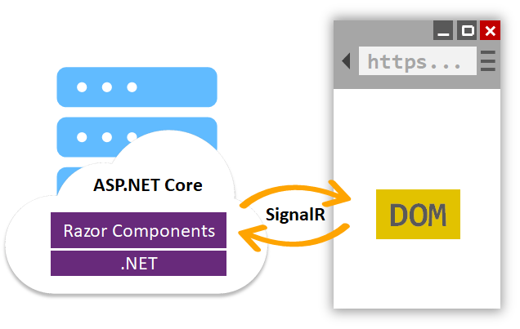
WebAssembly vs Server-side Blazor

Slide 14
And there’s even more
https://docs.microsoft.com/en-us/mobile-blazor-bindings/
https://devblogs.microsoft.com/aspnet/hybrid-blazor-apps-in-mobile-blazor-bindings-july-update/

Slide 15
Getting Started with Blazor
Make sure you have installed the latest version of Visual Studio (Community Edition is free) / Visual Studio Code
You can even try the preview version for the latest Blazor features
When installing VS make sure you check the
Data storage and processing workload
ASP Net and Web development
.Net Core cross-platform development
Make sure you have the latest .Net Core 3.1 SDK (normally installed with VS)

Slide 16

Hands-on
Create a Blazor WebAssembly project in Visual Studio

Slide 17
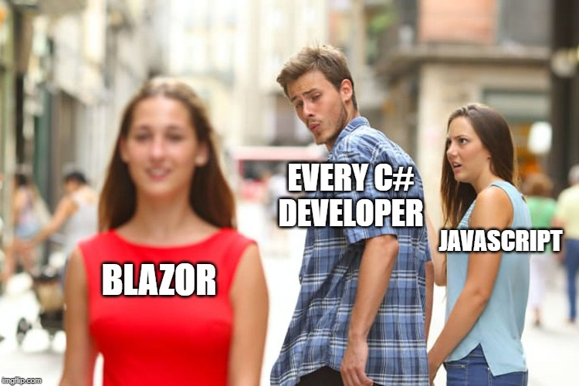
Convinced yet?

Slide 18
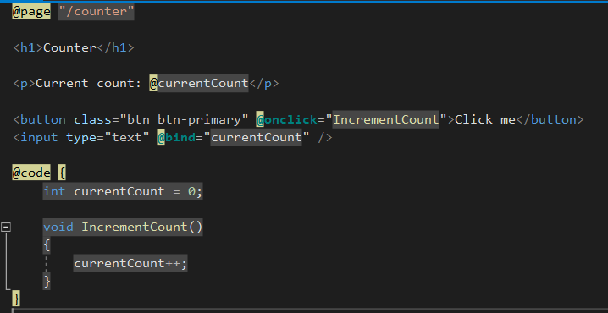
A Blazor page
Routing
The page HTML
or the page layout
(Razor syntax that
you know and love)
The page behavior code
(only C# code)

Slide 19
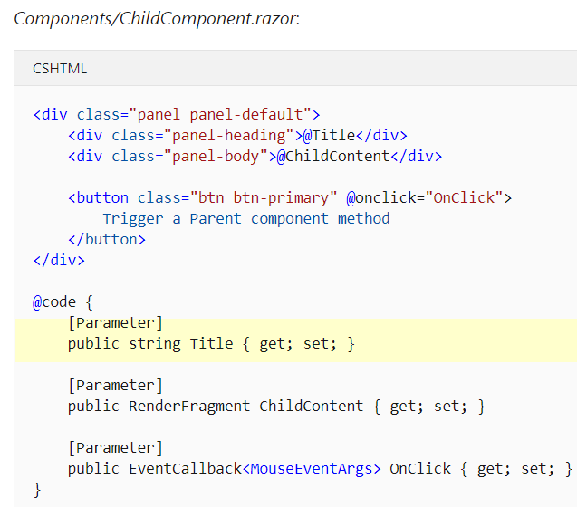
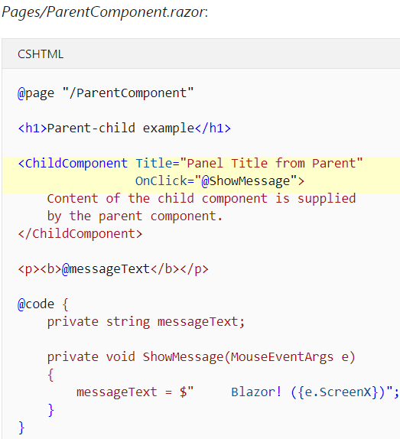
A Blazor component

Slide 20
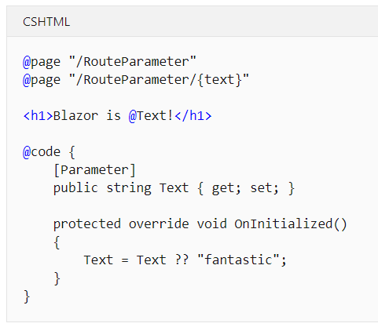
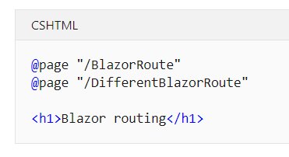
Routing
Multiple routes
Route parameters

Slide 21
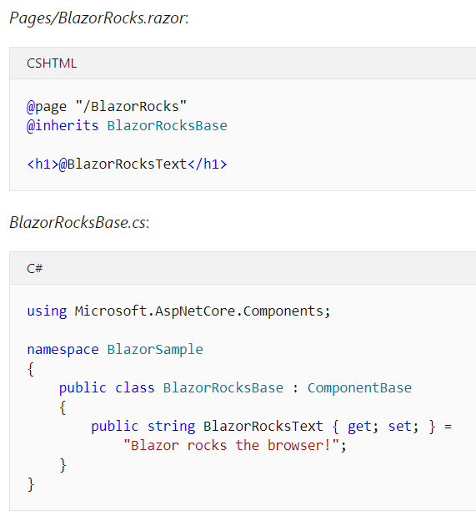
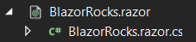
Separate file for the C# (behaviour) code
Or create a partial class
with the same name

Slide 22
Component Lifecycle methods
protected override async Task OnInitializedAsync() { await ... }
protected override void OnInitialized() { ... }
public override async Task SetParametersAsync(ParameterView parameters) { await ...
await base.SetParametersAsync(parameters);
}
protected override async Task OnParametersSetAsync() { await... }
protected override void OnAfterRender(bool firstRender) {
if (firstRender) { ... }
}
@implements IDisposable
@code {
public void Dispose() { ... }
}
protected override bool ShouldRender() {
return false;
}
Suppress component
render
TIP: Calling StateHasChanged() notifies the component that its state has changed so it is rerendered.

Slide 23
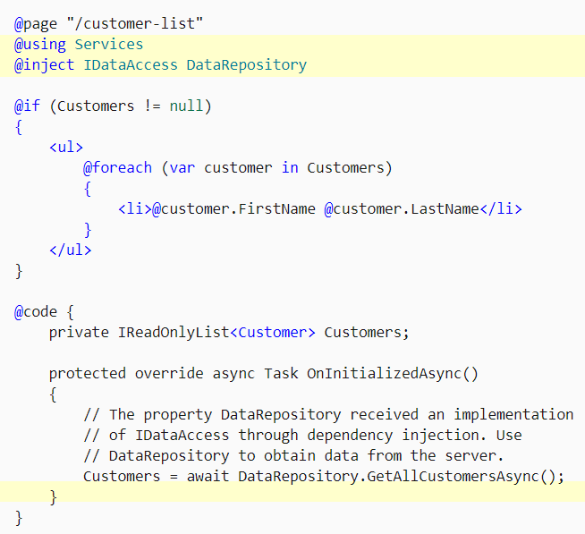
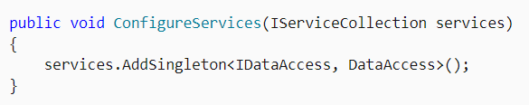
Dependency Injection
Add your service in Startup.cs

Slide 24
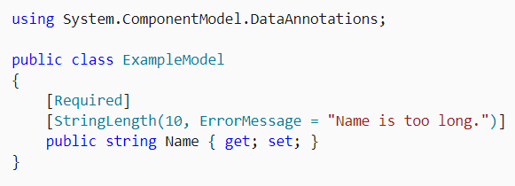
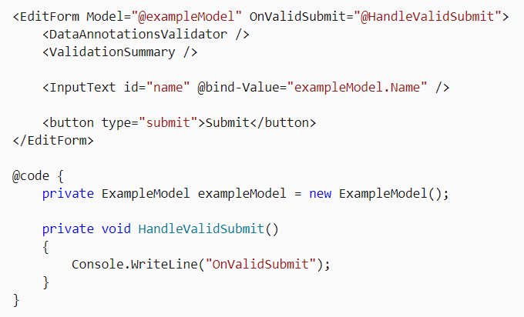
Forms and validation
Input component | Rendered as…
InputText | <input>
InputTextArea | <textarea>
InputSelect | <select>
InputNumber | <input type="number">
InputCheckbox | <input type="checkbox">
InputDate | <input type="date">

Slide 25
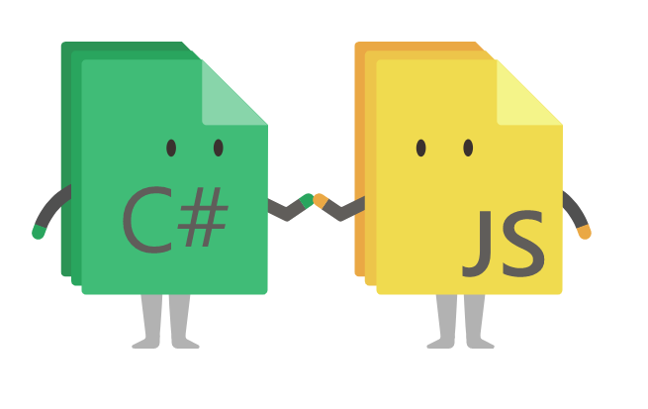
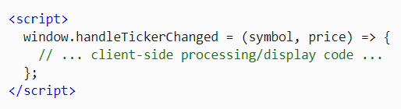
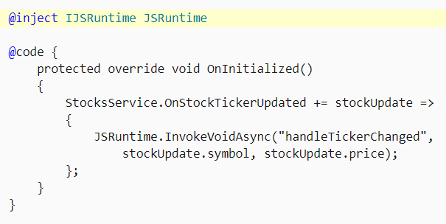
JavaScript interop
Your C# code can easily call JavaScript APIs and libraries. You can continue to use the large ecosystem of JavaScript libraries that exist for client side UI while writing your logic in C#.

Slide 26

Hands-on
Let’s build a small BlazorServer App

Slide 28
Used commands
(Or any other terminal - run on project root directory)
dotnet ef migrations add “MigrationName”
dotnet ef database update
dotnet new blazorserver --name ProjectName --auth Individual
dotnet new blazorwasm --name ProjectName --auth Individual
dotnet run
dotnet watch run

Slide 29
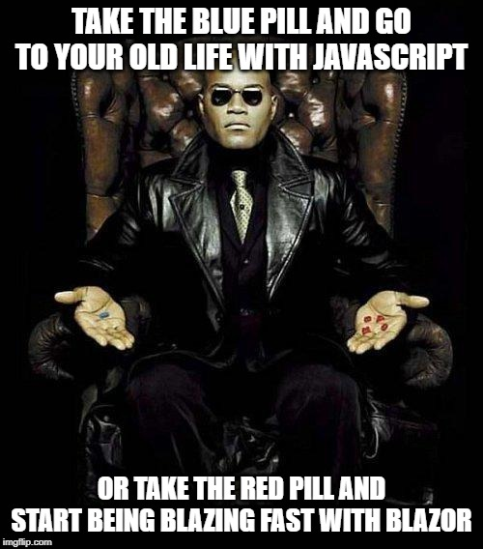
What will you choose?

Slide 30
Resources
Awesome Blazor - Lots of cool resources: https://awesomeopensource.com/project/AdrienTorris/awesome-blazor
Free Blazor components: https://blazor.radzen.com/
Blazorise - Free Bootstrap Blazor implementation: https://blazorise.com/docs/start/
WPF Blazor Components: https://github.com/aboudoux/WpfGridLayout.Blazor
Blazor documentation: https://docs.microsoft.com/en-us/aspnet/core/blazor/?view=aspnetcore-3.0
Blazor university: https://blazor-university.com/overview/what-is-blazor/

Slide 31

Questions?

Slide 32




Feedback
Completați acum
Durează 2-3 minute
Feedback anonim - pentru formator și AgileHub
http://bit.ly/peakit003-feedback

